Slide 1
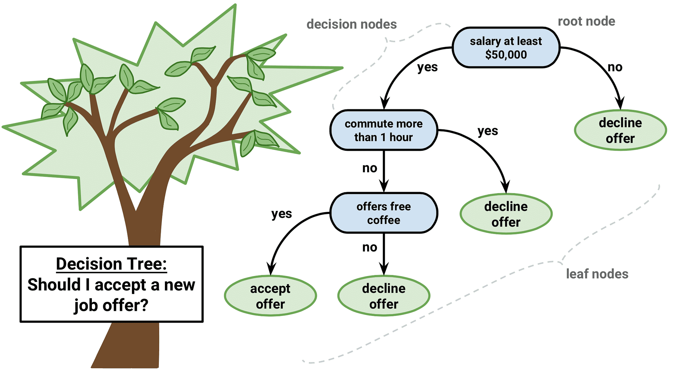
Data Mining Algorithms
Decision Tree: Gini index, Information gain.
Dr. Nilina Bera | CSE(DS) | HITK

Slide 2
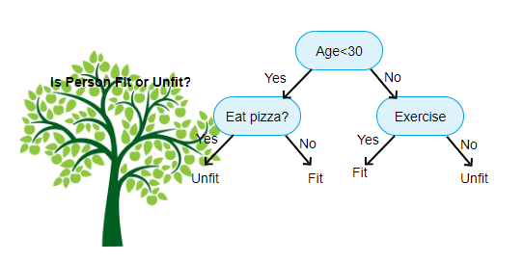
Decision Tree Classifier
The tree has three types of nodes:
• A root node, with no incoming links and zero or more outgoing links.
• Internal nodes, each of which has exactly one incoming link and two or more outgoing links.
• Leaf or terminal nodes, each of which has exactly one incoming link and no outgoing links.
Every leaf node in the decision tree is associated with a class label. The non-terminal nodes, which include the root and internal nodes, contain attribute test conditions that are typically defined using a single attribute.
Each possible outcome of the attribute test condition is associated with exactly one child of this node.

Slide 3
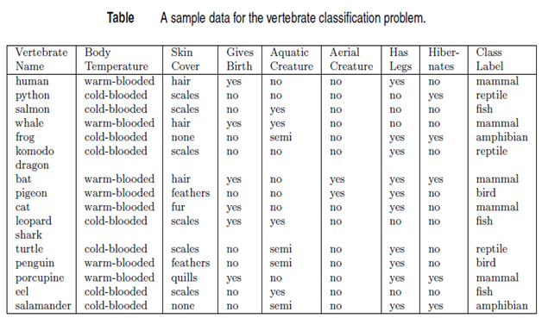

Slide 4
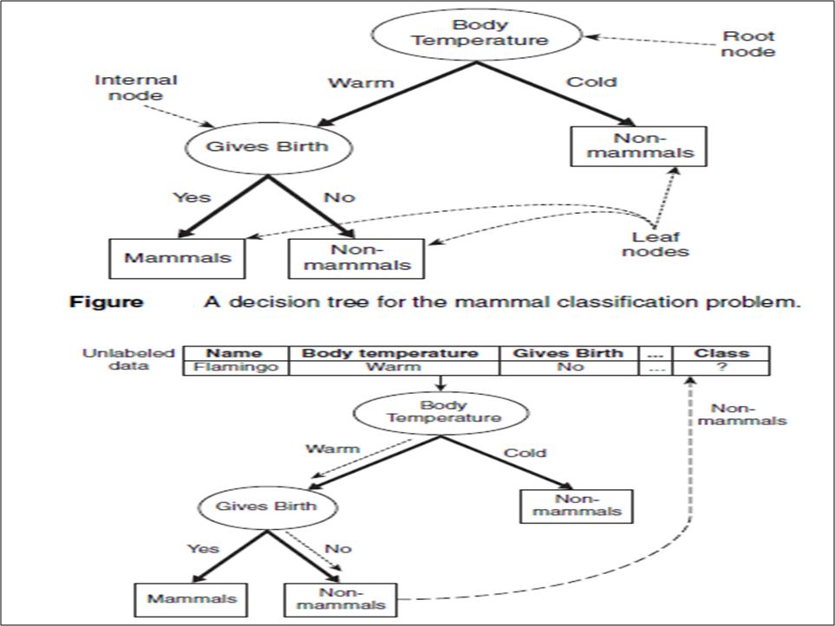
Decision Tree Classifier
Classifying an unlabeled vertebrate. The dashed lines represent the outcomes of applying
various attribute test conditions on the unlabeled vertebrate. The vertebrate is eventually assigned to
the Non-mammals class.

Slide 5
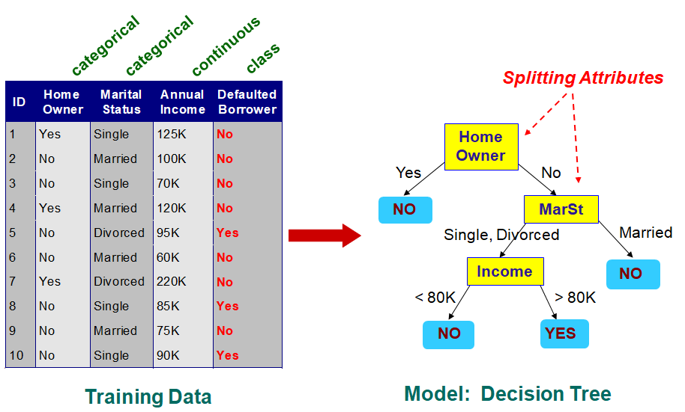
Example of a Decision Tree
categorical
categorical
continuous
class
Splitting Attributes
Home Owner
Yes
No
NO
MarSt
Single, Divorced
Married
Income
NO
< 80K
> 80K
NO
YES
Training Data
Model: Decision Tree

Slide 6
Another Example of Decision Tree
categorical
categorical
continuous
class
Single, Divorced
MarSt
Married
NO
Home Owner
Yes
No
NO
Income
< 80K
> 80K
NO
YES
There could be more than one tree that fits the same data!

Slide 7
Apply Model to Test Data
Test Data
Start from the root of tree.
Home Owner
Yes
No
NO
MarSt
Single, Divorced
Married
Income
NO
< 80K
> 80K
NO
YES

Slide 8
Apply Model to Test Data
Test Data
Home Owner
Yes
No
NO
MarSt
Single, Divorced
Married
Income
NO
< 80K
> 80K
NO
YES

Slide 9
Apply Model to Test Data
Test Data
Home Owner
Yes
No
NO
MarSt
Single, Divorced
Married
Income
NO
< 80K
> 80K
NO
YES

Slide 10
Apply Model to Test Data
Test Data
Home Owner
Yes
No
NO
MarSt
Single, Divorced
Married
Income
NO
< 80K
> 80K
NO
YES

Slide 11
Apply Model to Test Data
Test Data
Home Owner
Yes
No
NO
MarSt
Single, Divorced
Married
Income
NO
< 80K
> 80K
NO
YES

Slide 12
Apply Model to Test Data
Test Data
Home Owner
Yes
No
NO
MarSt
Single, Divorced
Married
Assign Defaulted to “No”
Income
NO
< 80K
> 80K
NO
YES

Slide 13
Decision Tree Classification Task
Decision Tree

Slide 14
Decision Tree Induction
Many Algorithms:
Hunt’s Algorithm (one of the earliest)
CART
ID3, C4.5
SLIQ,SPRINT

Slide 15
General Structure of Hunt’s Algorithm
In Hunt’s algorithm, a decision tree is grown in a recursive fashion.
The tree initially contains a single root node that is associated with all the training instances.
If a node is associated with instances from more than one class, it is expanded using an attribute test condition that is determined using a splitting criterion.
A child leaf node is created for each outcome of the attribute test condition and the instances associated with the parent node are distributed to the children based on the test outcomes.
Table - I

Slide 16
General Structure of Hunt’s Algorithm
This node expansion step can then be recursively applied to each child node, as long as it has labels of more than one class.
If all the instances associated with a leaf node have identical class labels, then the node is not expanded any further.
Each leaf node is assigned a class label that occurs most frequently in the training instances associated with the node.
Consider the training set shown in Table-I for the loan borrower classification problem. Suppose we apply Hunt’s algorithm to fit the training data.
The tree initially contains only a single leaf node as shown in Figure (a). This node is labelled as Defaulted = No, since the majority of the borrowers did not default on their loan payments.
The training error of this tree is 30% as three out of the ten training instances have the class label Defaulted = Yes.
The leaf node can therefore be further expanded because it contains training instances from more than one class.
Let Home Owner be the attribute chosen to split the training instances. The resulting binary split on the Home Owner attribute is shown in Figure (b).
All the training instances for which Home Owner = Yes are propagated to the left child of the root node and the rest are propagated to the right child.

Slide 17
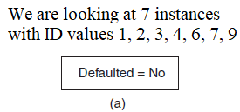
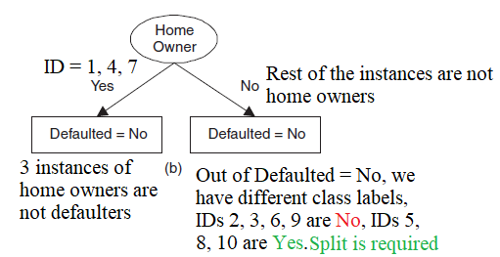
General Structure of Hunt’s Algorithm
Hunt’s algorithm is then recursively applied to each child. The left child becomes a leaf node labelled Defaulted = No, since all instances associated with this node have identical class label Defaulted = No.
The right child has instances from each class label. Hence, we split it further. The resulting sub trees after recursively expanding the right child are shown in Figures (c) and (d).
Training Error is instances with ID = 5, 8, 10 each having Defaulted = Yes, this is 3_{/10} i.e., 30%

Slide 18
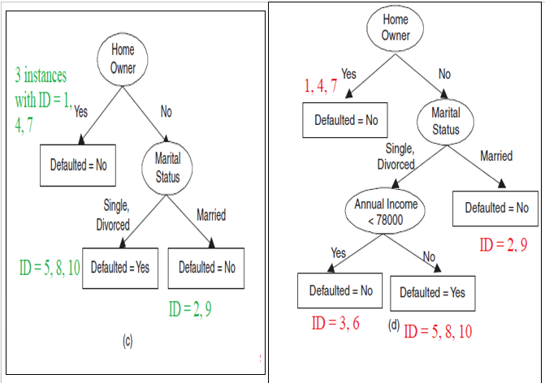
Split based on 1) Home Owner, 2) Marital Status, 3) Annual Income
Split based on 1) Home Owner, 2) Marital Status

Slide 19
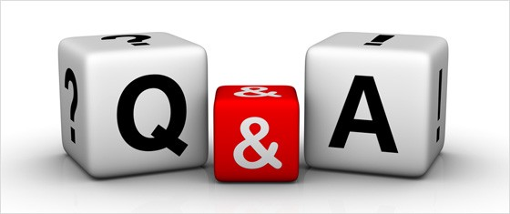

1. A _________ is a decision support tool that uses a tree-like graph or model of decisions and their possible consequences, including chance event outcomes, resource costs, and utility. a) Decision tree b) Graphs c) Trees d) Neural Networks
Ans: a)
2. Decision Tree is a display of an algorithm. a) True b) False
Ans: a)
3. What is Decision Tree? a) Flow-Chart b) Structure in which internal node represents test on an attribute, each branch represents outcome of test and each leaf node represents class label c) Flow-Chart & Structure in which internal node represents test on an attribute, each branch represents outcome of test and each leaf node represents class label d) None of the mentioned
Answer: c

Slide 20
4. Decision Trees can be used for Classification Tasks. a) True b) False
Answer: a
5. Which of the following are the advantage/s of Decision Trees? a) Possible Scenarios can be added b) Use a white box model, If given result is provided by a model c) Worst, best and expected values can be determined for different scenarios d) All of the mentioned
Answer: c
6. What are tree based classifiers?
Classifiers which form a tree with each attribute at one level
Classifiers which perform series of condition checking with one attribute at a time
Both options except none
None of the options
Ans: c

Slide 21
Design Issues of Decision Tree Induction
How should training records be split?
Method for specifying test condition
depending on attribute types
Measure for evaluating the goodness of a test condition
How should the splitting procedure stop?
Stop splitting if all the records belong to the same class or have identical attribute values
Early termination

Slide 22
Methods for Expressing Test Conditions
Depends on attribute types
Binary
Nominal
Ordinal
Continuous
Depends on number of ways to split
2-way split
Multi-way split

Slide 24
Test Condition for Nominal Attributes
Multi-way split:
Use as many partitions as distinct values.
Binary split:
Divides values into two subsets

Slide 25
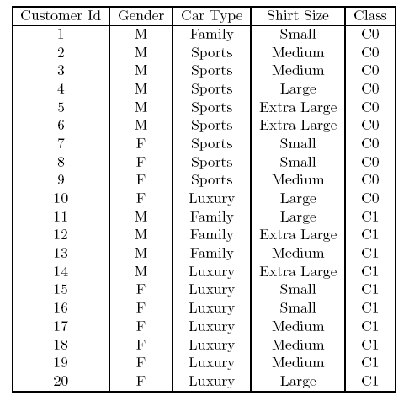

Slide 26
Test Condition for Ordinal Attributes
Multi-way split:
Use as many partitions as distinct values
Binary split:
Divides values into two subsets
Preserve order property among attribute values
(a), (b)
The groupings shown in Figures (a) and (b) preserve the order among the attribute values, whereas the grouping shown in Figure (c) violates this property because it combines the attribute values Small and Large into the same partition while Medium and Extra Large are combined into another partition.
(C)
This grouping violates order property

Slide 27
Test Condition for Continuous Attributes
For continuous attributes, the attribute test condition can be expressed as a comparison test (e.g., A < v) producing a binary split, or as a range query of the form vi ≤ A < vi+1, for i = 1, . . . , k, producing a multiway split. The difference between these approaches is shown in the above Figure. For the binary split, any possible value v between the minimum and maximum attribute values in the training data can be used for constructing the comparison test A < v.

Slide 28
Splitting Based on Continuous Attributes
Different ways of handling
Discretization to form an ordinal categorical attribute
Ranges can be found by equal interval bucketing, equal frequency bucketing (percentiles), or clustering.
Static – discretize once at the beginning
Dynamic – repeat at each node
Binary Decision: (A < v) or (A ≥ v)
consider all possible splits and finds the best cut
can be more compute intensive

Slide 29
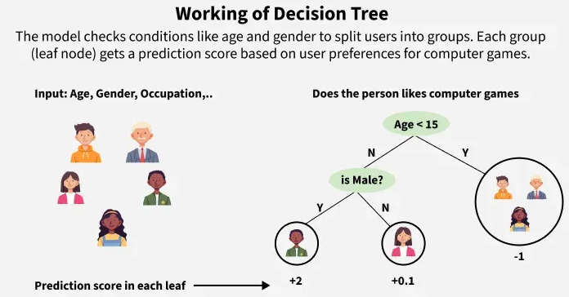

Slide 30
How to determine the Best Split
Before Splitting:
10 records of class 0,
10 records of class 1
M
F
Which test condition is the best?

Slide 31
Measures for Selecting an Attribute Test Condition
There are many measures that can be used to determine the goodness of an attribute test condition.
These measures try to give preference to attribute test conditions that partition the training instances into purer subsets in the child nodes, which mostly have the same class labels.
Having purer nodes is useful since a node that has all of its training instances from the same class does not need to be expanded further.
In contrast, an impure node containing training instances from multiple classes is likely to require several levels of node expansions, thereby increasing the depth of the tree considerably.
Larger trees are less desirable as they are more susceptible to model over fitting, a condition that may degrade the classification performance on unseen instances.
They are also difficult to interpret and incur more training and test time as compared to smaller trees.

Slide 32
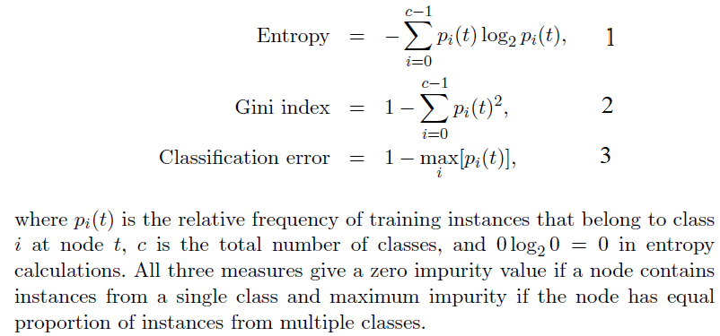
Impurity Measure for a Single Node
The impurity of a node measures how dissimilar the class labels are for the data instances belonging to a common node. Following are examples of measures that can be used to evaluate the impurity of a node t:

Slide 33
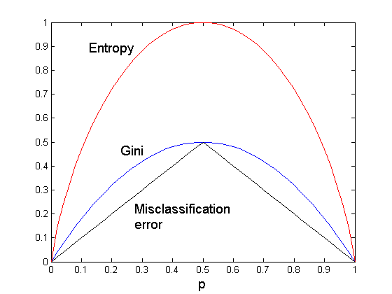
Comparison among Impurity Measures
For a 2-class problem:
Figure X
The above Figure X compares the relative magnitude of the impurity measures
when applied to binary classification problems (i.e., 2-class problem).

Slide 35
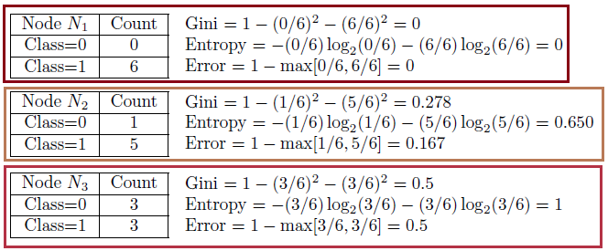
Impurity Measure for a Single Node
Since there are only two classes, p0(t)+p1(t) = 1. The horizontal axis p refers to the fraction of instances that belong to one of the two classes. Observe that all three measures attain their maximum value when the class distribution is uniform (i.e., p0(t) = p1(t) = 0.5) and minimum value when all the instances belong to a single class (i.e., either p0(t) or p1(t) equals to 1). The following examples illustrate how the values of the impurity measures vary as we alter the class distribution.

Slide 36
Impurity Measure for a Single Node
Based on these calculations, node N1 has the lowest impurity value, followed by N2 and N3. This example, along with Figure X, shows the consistency among the impurity measures, i.e., if a node N1 has lower entropy than node N2, then the Gini index and error rate of N1 will also be lower than that of N2.
Node | Class | Count | Gini | Entropy | Error
N1 | Class-0 | 0 | 0 | 0 | 0
 | Class-1 | 6
N2 | Class-0 | 1 | 0.278 | 0.65 | 0.167
 | Class-1 | 5
N4 | Class-0 | 2 | 0.442 | 0.942 | 0.33
 | Class-1 | 4
N3 | Class-0 | 3 | 0.5 | 1 | 0.5
 | Class-1 | 3

Slide 37
Q. Consider the training examples shown in Table 1 for a binary classification problem.
(i) Compute the Gini index for the Gender attribute
(ii) Compute the Gini index for the Car Type and Shirt Size attributes using multiway split.

Slide 38
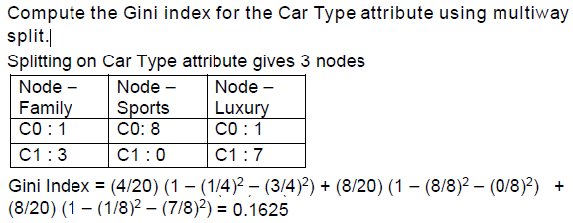
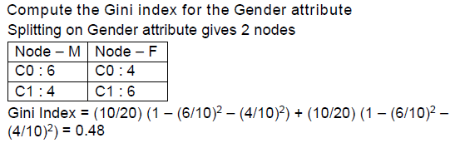
Ans:
Compute the Gini index for the Shirt Size attribute using multiway split.
Splitting on Shirt Size attribute gives 4 nodes:
Node - Small | Node - Medium | Node - Large | Node - Extra Large
C0: 3 | C0: 3 | C0: 2 | C0: 2
C1: 2 | C1: 4 | C1: 2 | C1: 2
Gini Index = ?

Slide 39
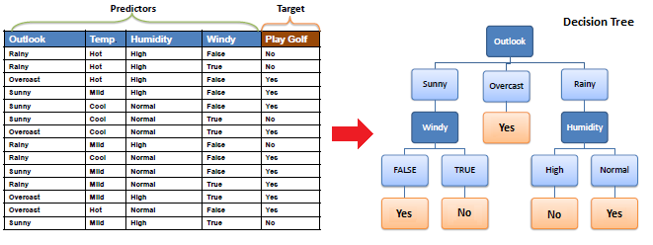

Slide 40
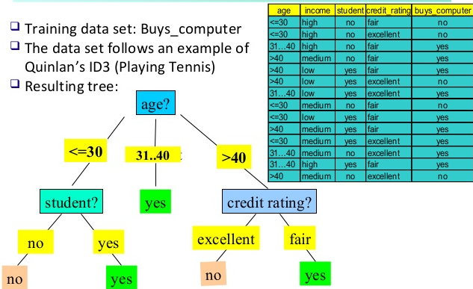

Slide 41
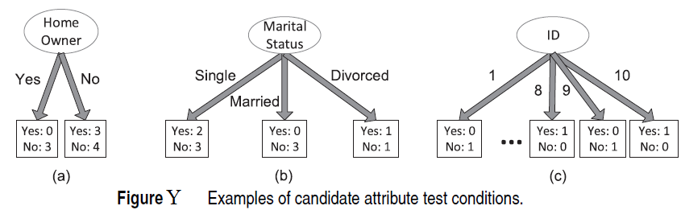
Example: [Weighted Entropy] Consider the candidate attribute test condition shown in Figures Y(a) and (b) for the loan borrower classification problem. Splitting on the Home Owner attribute will generate two child nodes whose weighted entropy can be calculated as follows:

Slide 42
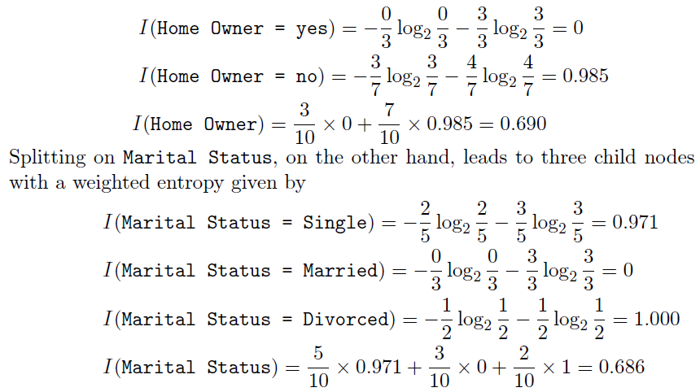
Thus, Marital Status has a lower weighted entropy than Home Owner.

Slide 43
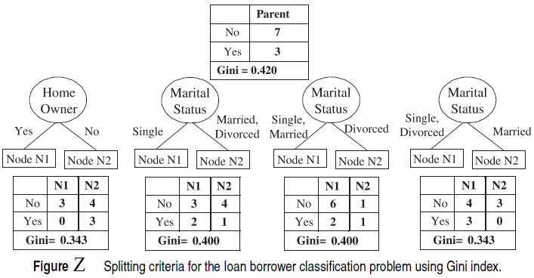
Identifying the best attribute test condition
To determine the goodness of an attribute test condition, we need to compare the degree of impurity of the parent node (before splitting) with the weighted degree of impurity of the child nodes (after splitting). The larger their difference, the better the test condition. This difference, Δ, also termed as the gain in purity of an attribute test condition, can be defined as follows:
Δ = I(parent) − I(children),

Slide 44
where I(parent) is the impurity of a node before splitting and I(children) is the weighted impurity measure after splitting. It can be shown that the gain is non-negative since I(parent) ≥ I(children) for any reasonable measure such as those presented above.
The higher the gain, the purer are the classes in the child nodes relative to the parent node.
The splitting criterion in the decision tree learning algorithm selects the attribute test condition that shows the maximum gain.
Note that maximizing the gain at a given node is equivalent to minimizing the weighted impurity measure of its children since I(parent) is the same for all candidate attribute test conditions.
Finally, when entropy is used as the impurity measure, the difference in entropy is commonly known as information gain, Δinfo.
In the following, illustrative approaches for identifying the best attribute test condition given qualitative or quantitative attributes are presented.

Slide 45

Splitting of Qualitative Attributes
Consider the first two candidate splits shown in Figure Y involving qualitative attributes Home Owner and Marital Status. The initial class distribution at the parent node is (0.3, 0.7), since there are 3 instances of class Yes and 7 instances of class No in the training data. Thus,
The information gains for Home Owner and Marital Status are each given by
Δinfo(Home Owner) = 0.881 − 0.690 = 0.191
Δinfo(Marital Status) = 0.881 − 0.686 = 0.195
The information gain for Marital Status is thus higher due to its lower
weighted entropy, which will thus be considered for splitting.

Slide 46
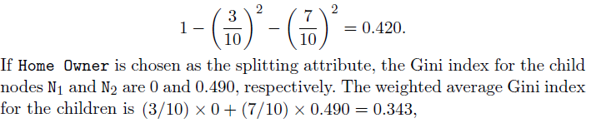
Binary Splitting of Qualitative Attributes
Consider building a decision tree using only binary splits and the Gini index as the impurity measure. Figure Z shows examples of four candidate splitting criteria for the Home Owner and Marital Status attributes. Since there are 3 borrowers in the training set who defaulted and 7 others who repaid their loan (see Table in Figure Z), the Gini index of the parent node before splitting is:
where the weights represent the proportion of training instances assigned to each child. The gain using Home Owner as splitting attribute is 0.420 - 0.343 = 0.077. Similarly, we can apply a binary split on the Marital Status attribute.
However, since Marital Status is a nominal attribute with three outcomes, there are three possible ways to group the attribute values into a binary split.
The weighted average Gini index of the children for each candidate binary split is shown in Figure Z. Based on these results, Home Owner and the last binary split using Marital Status are clearly the best candidates, since they both produce the lowest weighted average Gini index. Binary splits can also be used for ordinal attributes, if the binary partitioning of the attribute values does not violate the ordering property of the values.

Slide 47

What is gini index?
It is a type of index structure
It is a measure of purity
Both options except none
None of the options
Ans: b
Tree/Rule based classification algorithms generate ... rule to perform the classification.
if-then.
while.
do while.
switch.
Ans: a

Slide 48
Algorithm is:
A. It uses machine-learning techniques. Here program can learn from past experience and adapt themselves to new situations
B. Computational procedure that takes some value as input and produces some value as output
C. Science of making machines performs tasks that would require intelligence when performed by humans
D. None of these
Ans: B
Classification is:
A. A subdivision of a set of examples into a number of classes
B. A measure of the accuracy, of the classification of a concept that is given by a certain theory
C. The task of assigning a classification to a set of examples
D. None of these
Ans: A

Slide 49
Binary attributes are:
A. This takes only two values. In general, these values will be 0 and 1 and they can be coded as one bit
B. The natural environment of a certain species
C. Systems that can be used without knowledge of internal operations
D. None of these
Data mining is:
A. The actual discovery phase of a knowledge discovery process
B. The stage of selecting the right data for a KDD process
C. A subject-oriented integrated time variant non-volatile collection of data in support of management
D. None of these
Ans: A
Ans: A

Slide 50
Discovery is:
A. It is hidden within a database and can only be recovered if one is given certain clues (an example IS encrypted information).
B. The process of executing implicit previously unknown and potentially useful information from data
C. An extremely complex molecule that occurs in human chromosomes and that carries genetic information in the form of genes.
D. None of these
Hidden knowledge referred to:
A. A set of databases from different vendors, possibly using different database paradigms
B. An approach to a problem that is not guaranteed to work but performs well in most cases
C. Information that is hidden in a database and that cannot be recovered by a simple SQL query.
D. None of these
Ans: B
Ans: C

Slide 51
KDD (Knowledge Discovery in Databases) is referred to:
A. Non-trivial extraction of implicit previously unknown and potentially useful information from data
B. Set of columns in a database table that can be used to identify each record within this table uniquely.
C. collection of interesting and useful patterns in a database
D. none of these
Knowledge is referred to:
A. Non-trivial extraction of implicit previously unknown and potentially useful information from data
B. Set of columns in a database table that can be used to identify each record within this table uniquely
C. collection of interesting and useful patterns in a database
D. none of these
Ans: A
Ans: C

Slide 52
1. What is the main purpose of using Gini Index and Information Gain in Decision Trees?
A. To prune the tree B. To split the dataset at each node
C. To normalize data D. To reduce overfitting
→ B. To split the dataset at each node
2. What is the range of the Gini Index?
A. 0 to 0.5 B. 0 to 1 C. -1 to 1 D. 0 to infinity
→ B. 0 to 1
3. Which of the following indicates a pure node in the Gini Index?
A. Gini = 0 B. Gini = 0.5 C. Gini = 1 D. Gini = -1
→ A. Gini = 0
4. What does Information Gain measure?
A. Variance of the data B. Purity of data after the split
C. Depth of the tree D. Accuracy of the model
→ B. Purity of data after the split
5. Which metric is based on entropy?
A. Gini Index B. Information Gain C. Variance D. Mean Square Error
→ B. Information Gain

Slide 53
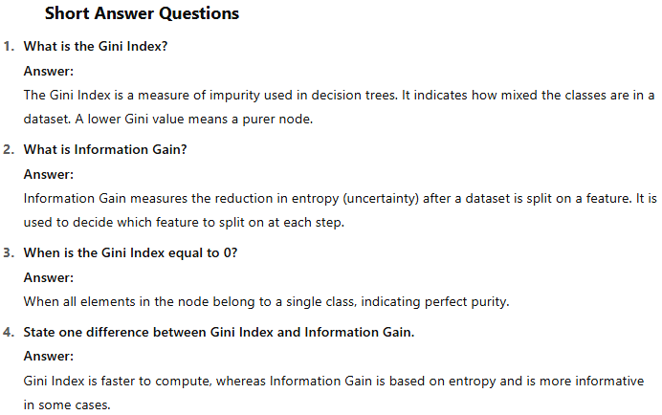

Slide 54
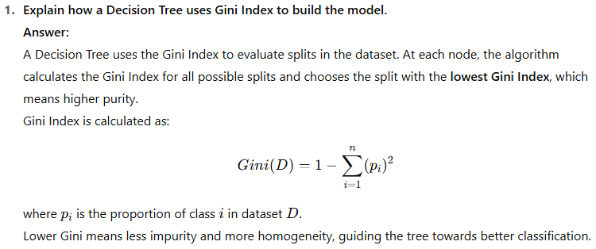

Slide 55
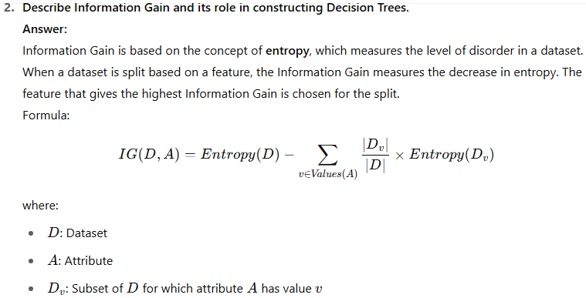

Slide 56
3. Compare Gini Index and Information Gain. Which one is better? Answer: Both Gini Index and Information Gain are used to split nodes in decision trees.
Gini Index is computationally more efficient and prefers larger partitions with smaller impurity.
Information Gain tends to favor attributes with more distinct values, and it is theoretically more sound due to its basis in information theory.
Which is better? It depends on the data. Gini is preferred in CART algorithms, while Information Gain is used in ID3 and C4.5. In practice, the choice is often empirical.

Slide 57
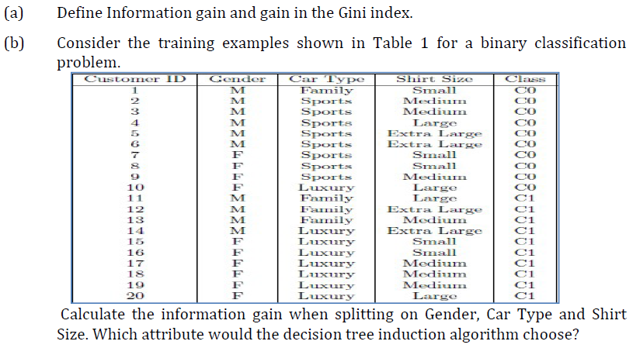

Slide 58
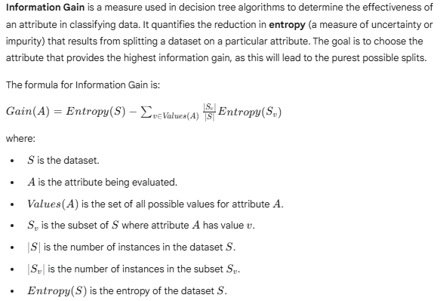
(a) Define Information gain and gain in the Gini index.

Slide 59
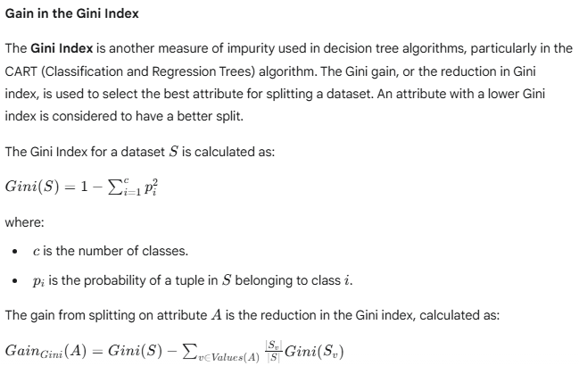

Slide 60
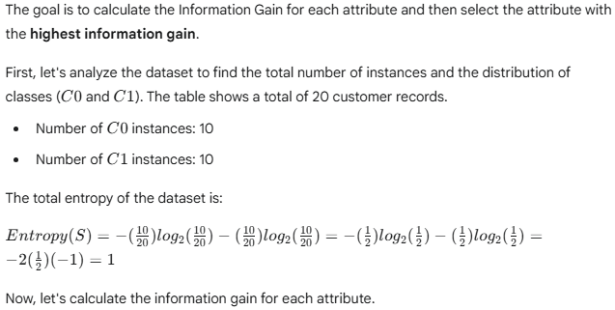
(b) Calculate the information gain when splitting on Gender, Car Type and Shirt Size. Which attribute would the decision tree induction algorithm choose?

Slide 61
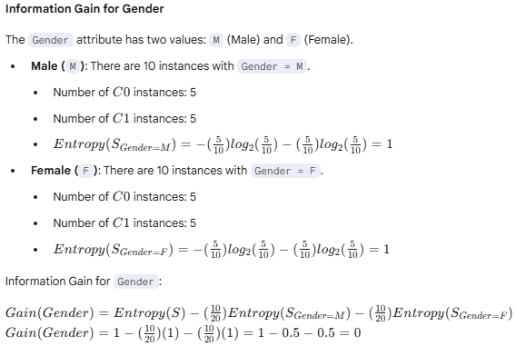

Slide 62
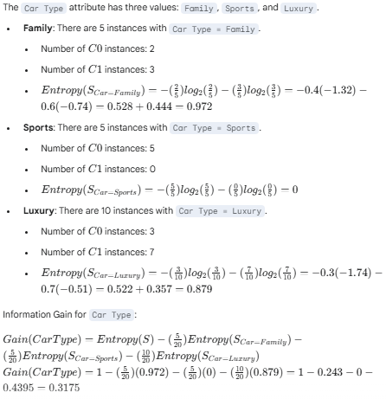
Information Gain for Car Type

Slide 63
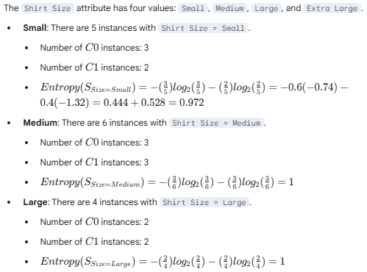
Information Gain for Shirt Size

Slide 64
